Slide 1
Central Consolidated School District
Preliminary Budget Presentation SY 2021-2022
Updated for March 24, 2021

Slide 2
Agenda
Mission/Vision/Budget Purpose
District Facts
Staff Counts
Student Counts
Overview of 2019-2020 Expenses
Operational Expenses
Finance Survey
New Positions for SY 20-21
Possible Legislative Mandates and News for SY 21-22
Questions

Slide 3
Central Consolidated School District: Mission & Vision
Vision: A community of learners dedicated to building lives.
Mission: Building a collaborative relationship within our collective community through continuous learning, open communication, and shared trust.

Slide 4
Purpose of a Budget
The purpose of a School District’s Operating Budget is to provide a statement, expressed in financial terms, that serves as the primary tool for planning and controlling operations.
More than numbers, it is a record of a district’s past decisions and a spending plan for its future.

Slide 5
SY 2020-2021 District Facts
4 High Schools
3 Middle Schools
8 Elementary Schools
1 Early Childhood Center
1 Early College High School
1 Charter School
960 Employees
5120 students (average)

Slide 6
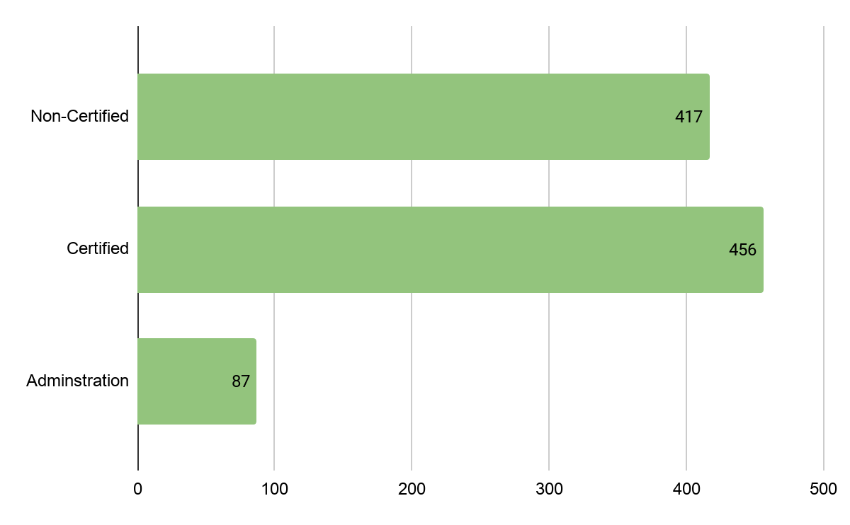
Employee Count by Type During 2020-2021 Total = 960

Slide 7
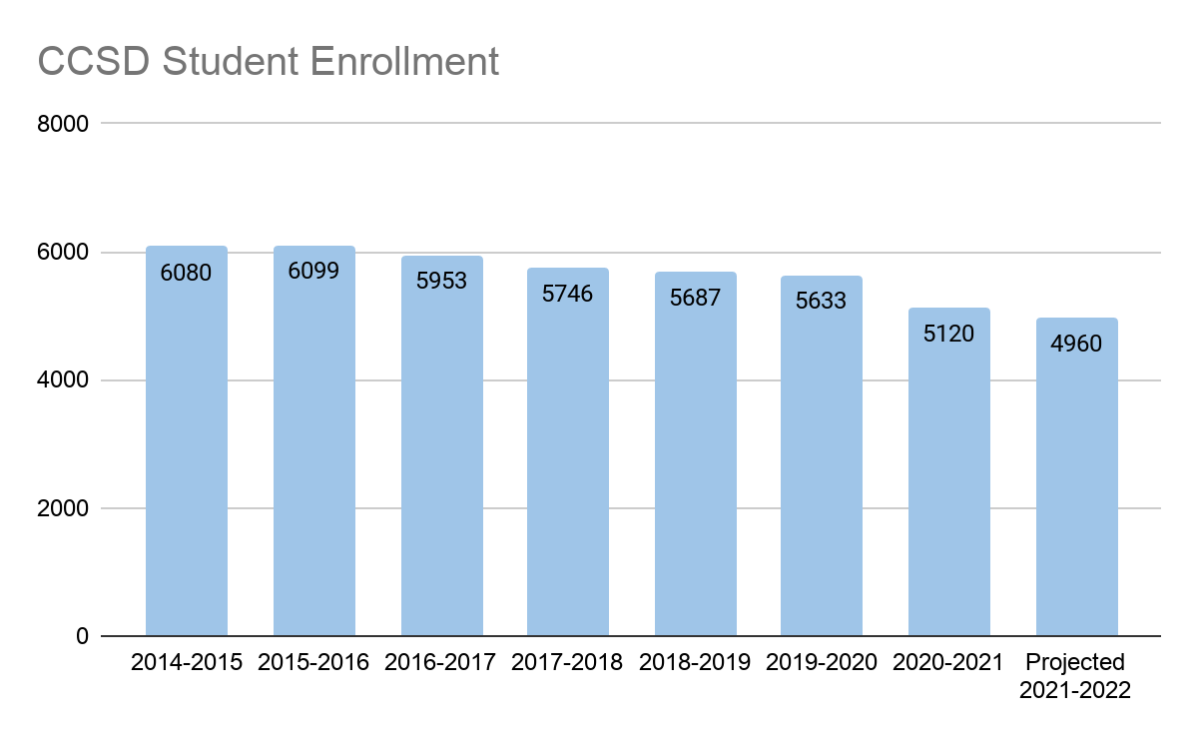
District Enrollment
Our projected Student Enrollment for SY 2021-2022 is 4960.
Projected Numbers show a decrease of 160 students from SY 20-21 to SY 21-22.

Slide 8
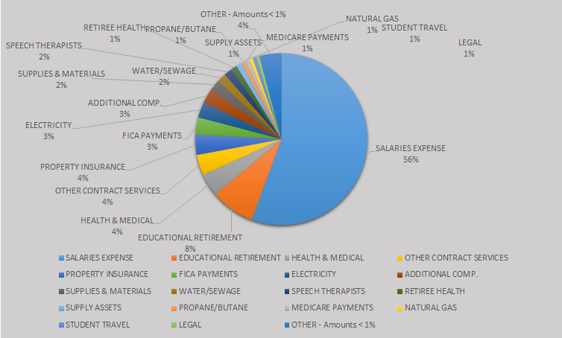
11000 Fund - Operational Expenses FY19-20 Total = $56,539,440

Slide 9
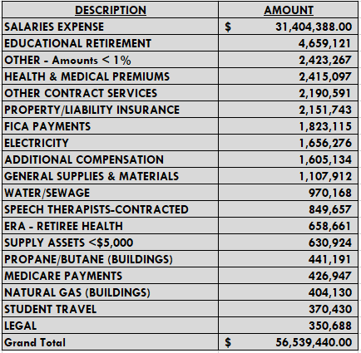
Expense Amounts

Slide 10
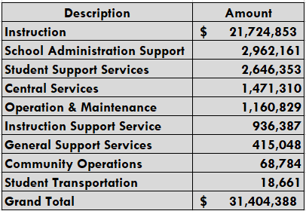
Salary Breakdown

Slide 11
FINANCE Budget Survey
•To get input from students, staff and community in regards to budget priorities for the upcoming school year 2021-2022 school year our department sent out a survey.
•The Survey consisted of 23 questions and was open to the public and staff on February 23, 2021 and we are still gathering the information from the surveys.
•Currently a total of 27 people participated in the budget survey.

Slide 12
Survey Results
Question: When building a budget, the top priorities should be…
Top Answers:
Social, emotional, behavioral, health and safety of students
Up to date classroom technology
Teacher to student ratio
Quality of teaching staff
Question: What items are most important to help support student education?
Top Answers:
Up to date technology in classrooms and its use in our schools
Middle/High School electives
Full Day Kindergarten
Advanced placement classes

Slide 13
Survey Results
Question: What items should the district continue investing in?
Top Answers:
Classroom technology
Afterschool programs
Art
Music
Question: If funds were available, which category would you like to see continued and/or improved?
Top Answers:
Technology
Staff development
Vocational programs
Student/Teacher ratio

Slide 14
New Positions for 20-21
(1) Dean of Students – Provide support to students at middle school
(2) Coordinators Positions: to serve the needs of the students, community, and staff.
Curriculum & Instruction
Intercultural Community Outreach Department
(1) Supervisor - Intercultural Community Outreach

Slide 15
Possible Upcoming Legislative Mandates for 2021-2022
Possible Changes in SEG (State Equalization Guarantee) amounts
SEG from 2022 is less than 2021 the State plans to issue funds from ESSER to fund admin cost/emergency needs to equal the difference. (01/15/2022) https://www.nmlegis.gov/Legislation/Legislation?Chamber=H&LegType=B&LegNo=2&year=21
Districts are required to offer paid sick leave or expand FMLA (Family Medical Leave Act) for Qualified reasons related to COVID 19 https://www.nmlegis.gov/Legislation/Legislation?Chamber=H&LegType=B&LegNo=2&year=21
upto 80 hours mimic (mirror FFCRA, Families First Coronavirus Response Act)
$11 Million statewide to provide “targeted and on-going professional development focused on case management, tutoring, data-guided instruction, coaching or other evidence-based practices to provide student outcomes” https://www.nmlegis.gov/Legislation/Legislation?Chamber=H&LegType=B&LegNo=2&year=21
K-12+ pilot programs will require 25 additional days. https://www.nmlegis.gov/Legislation/Legislation?Chamber=H&LegType=B&LegNo=2&year=21

Slide 16
Latest Legislative News Cont.
$8 million statewide evidence based structured literacy collaborative models to improve reading/writing for students K-2 (11/01/2021) https://www.nmlegis.gov/Legislation/Legislation?Chamber=H&LegType=B&LegNo=2&year=21
ESSR II (Elementary, Secondary School Education Relief & Economy Security) / CARES (Coronavirus Aid, Relief and Economic Security) act Funding for 2021-2022 School Year
Response to COVID related needs for LEAs (Local Educational Agency) approximately $9 million for CCSD https://webnew.ped.state.nm.us
House Bill 6: Impact Aide Program: Reduce in SEG, Restore the funds to fund facilities & technology infrastructure. https://www.ccsdnm.org/protected/ArticleView.aspx?iid=5GP3II&dasi=32B2
Additional updates will be posted in next upcoming budget meetings
April 14

Slide 17
Questions?
EMAIL: Finance@centralschools.org
PHONE:
(505) 598-5834 or
(505) 368-4984

